Slide 1
Chap#4
Servers

Slide 2
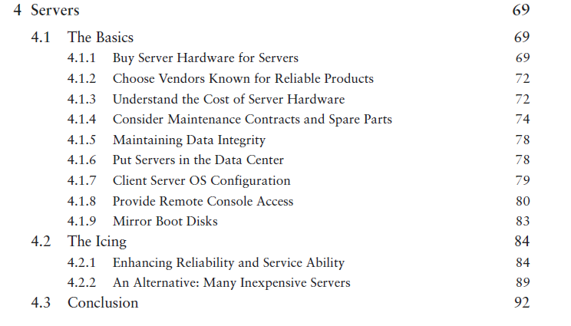

Slide 3
Introduction
This chapter is about servers. Unlike a workstation, which is dedicated to a single customer, multiple customers depend on a server.
Reliability and uptime are a high priority.
When we invest effort in making a server reliable, we look for features that will make repair time shorter, provide a better working environment, and use special care in the configuration process.
Servers are expected to last longer than workstations, which also justifies the additional cost.
Notes:
Reliability : the quality of being trustworthy or of performing consistently well.
Uptime : time during which a machine, especially a computer, is in operation.

Slide 4
4.1 The Basics
Hardware sold for use as a server is qualitatively different.
Server hardware has different features and is engineered to a different economic model.
Special procedures are used to install and support servers.
They typically have maintenance contracts, disk-backup systems, OS, better remote access, and servers reside in the controlled environment of a data center, where access to server hardware can be limited. Understanding these differences will help you make better purchasing decisions.

Slide 5
4.1.1 Buy Server Hardware for Servers
Systems sold as servers are different from systems.
It is often tempting to “save money” by purchasing desktop hardware and loading it with server software but is not the best choice for the long term or in a large installation.
Server hardware usually costs more but has additional features that justify the cost. Some of the features are
Extensibility
More CPU performance
High-performance I/O
Upgrade options
Rack mountable
No side-access needs
High-availability options
Maintenance contracts
Management options

Slide 6
4.1.2 Choose Vendors Known for Reliable Products
It is important to pick vendors that are known for reliability.
Vendors with more experience include the features listed earlier.
It can be useful to talk with other SAs to find out which vendors they use and which ones they avoid.
Environments can be homogeneous—all the same vendor or product line—or heterogeneous—many different vendors and/or product lines.
Homogeneous environments are easier to maintain, because training is reduced, maintenance and repairs are easier—one set of spares—and there is less finger pointing when problems arise.
heterogeneous environments have the benefit that you are not locked in to one vendor, and the competition among the vendors will result in better service to you.

Slide 7
4.1.3 Understand the Cost of Server Hardware
To understand the additional cost of servers, you must understand how machines are priced. You also need to understand how server features add to the cost of the machine.
Most vendors have three product lines: home, business, and server.

Slide 8
4.1.4 Consider Maintenance Contracts and Spare Parts
When purchasing a server, consider how repairs will be handled. All machines eventually break. Vendors tend to have a variety of maintenance contract options.
Some reasonable scenarios for picking appropriate maintenance contracts:
Non-critical server
Large groups of similar servers
Controlled introduction
Critical host
Large variety of models from same vendor
Highly critical host

Slide 9
4.1.5 Maintaining Data Integrity
Servers have critical data and unique configurations that must be protected.
Workstation clients are usually mass-produced with the same configuration on each one, and usually store their data on servers, which eliminates the need for backups.

Slide 10
4.1.6 Put Servers in the Data Center
Servers should be installed in an environment with proper power, fire protection, networking, cooling, and physical security.
After assembling the hardware, it is best to mount it in the rack immediately before installing the OS and other software.
Everyone should have a designated room or closet with physical security, UPS and proper cooling.

Slide 11
4.1.7 Client Server OS Configuration
Servers don’t have to run the same OS as their clients. OS but with a different configuration to account for the difference in intended usage.
A web server, for example, does not need to run the same OS as its clients.
Server is required to have all the same software as the clients. Consider the case of a UNIX environment with many UNIX desktops and a series of general-purpose UNIX CPU servers.
It is interesting to note that what is appropriate for a server OS is a matter of perspective.

Slide 12
4.1.8 Provide Remote Console Access
Servers need to be maintained remotely.
A KVM switch is a device that lets many machines share a single keyboard, video screen, and mouse (KVM).
Serial console concentrators now come in two forms: home brew or appliance.
Serial consoles and KVM switches have the benefit of permitting you to operate a system’s console when the network is down or when the system is in a bad state.
Some vendors have hardware cards to allow remote control of the machine.
Since a serial console is receiving a single stream of ASCII data, it is easy to record ,store and to find error.
Purchasing server hardware, one of your major considerations should be what kind of remote access to the console is available and determining which tasks require such access.
Remote access to consoles provides cost savings and improves safety factors for SA.
Security implications must be considered when you have a remote console.

